Slide 1
Water Tracker
Exploring the combination of live data, art, Internet of things and how this can be used to highlight the environmental impact of housing and waste of finite resources

Slide 2
Introduction
Hypothesis: Explore the combination of live data, art, Internet of things and how this can be used to highlight the environmental impact of housing and waste of finite resources.
Aims / Objectives: Look at how the internet of things can be used to show the importance of resource management within the home environment.
Build a resource measurement system based on the consumption of finite resources within the household, accompanied by a live data visual art piece.

Slide 3
Background
“We need experiences that stir strong feelings of connection. Artists are leading
the way to reconnect methods of analysis and expression”
(Roberts, 2015)
Roberts, L. (2015). Living data: how art helps us all understand climate change. [online] The Conversation. Available at: http://theconversation.com/living-data-how-art-helps-us-all-understand-climate-change-36890.

Slide 4
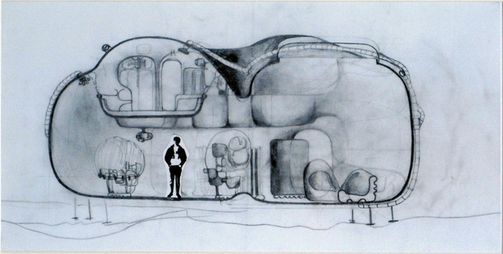
Background
One thousand Dreams of Stellavista, short sci-fi story written by J. G. Ballard
Psychotropic House
“it's not just dull, it’s dead”
(Ballard, 1992)
Ballard, J. (1992). Vermilion sands. London: Phoenix.

Slide 5
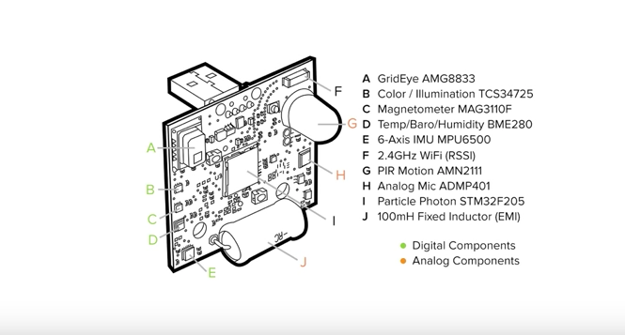
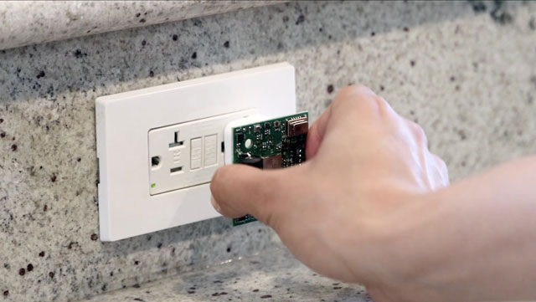
Background
Synthetic Sensor
“A single, highly capable sensor which can indirectly monitor a large context, without direct instrumentation of objects”
(Laput, 2018)
Laput, G. (n,d). Gierad Laput | Synthetic Sensors. [online] Gierad.com. Available at: http://www.gierad.com/projects/supersensor/.

Slide 6
Methodology
Started by looking at environmental impact of housing as a whole.
Then I had to define what a resource is.
Then what are the Resources found in the home? Electricity gas water Telecoms TV Parking Data Money
Limited the list down to naturally occurring resources to look at environmental impact.

Slide 7
Methodology
I begun research Into the 3 main naturally occurring Resources.
From that research I decided that water would be the best target resource for my project. “Basic access is the availability of a source of water that is at most 1,000 metres or 20 minutes away that affords the possibility of reliably obtaining at least 20 litres per day per family member” and “Optimal access allows for the consumption of 100 litres per person per day on average, supplied continuously through multiple taps and which meets all consumption and hygiene needs”
(Moral, 2015)
“the average water usage for people in the UK is about 150 litres per day”
(Onaverage.co.uk, 2018)
Moral, C. (2015). How many litres of water does a person need per day?. [online] Intelligent Infrastructure. Available at: https://blog.ferrovial.com/en/2015/03/how-many-litres-of-water-does-a-person-need-per-day/
Onaverage.co.uk. (2018). Average Water Usage | Onaverage.co.uk. [online] Available at: https://www.onaverage.co.uk/consumption-averages/average-water-usage

Slide 8
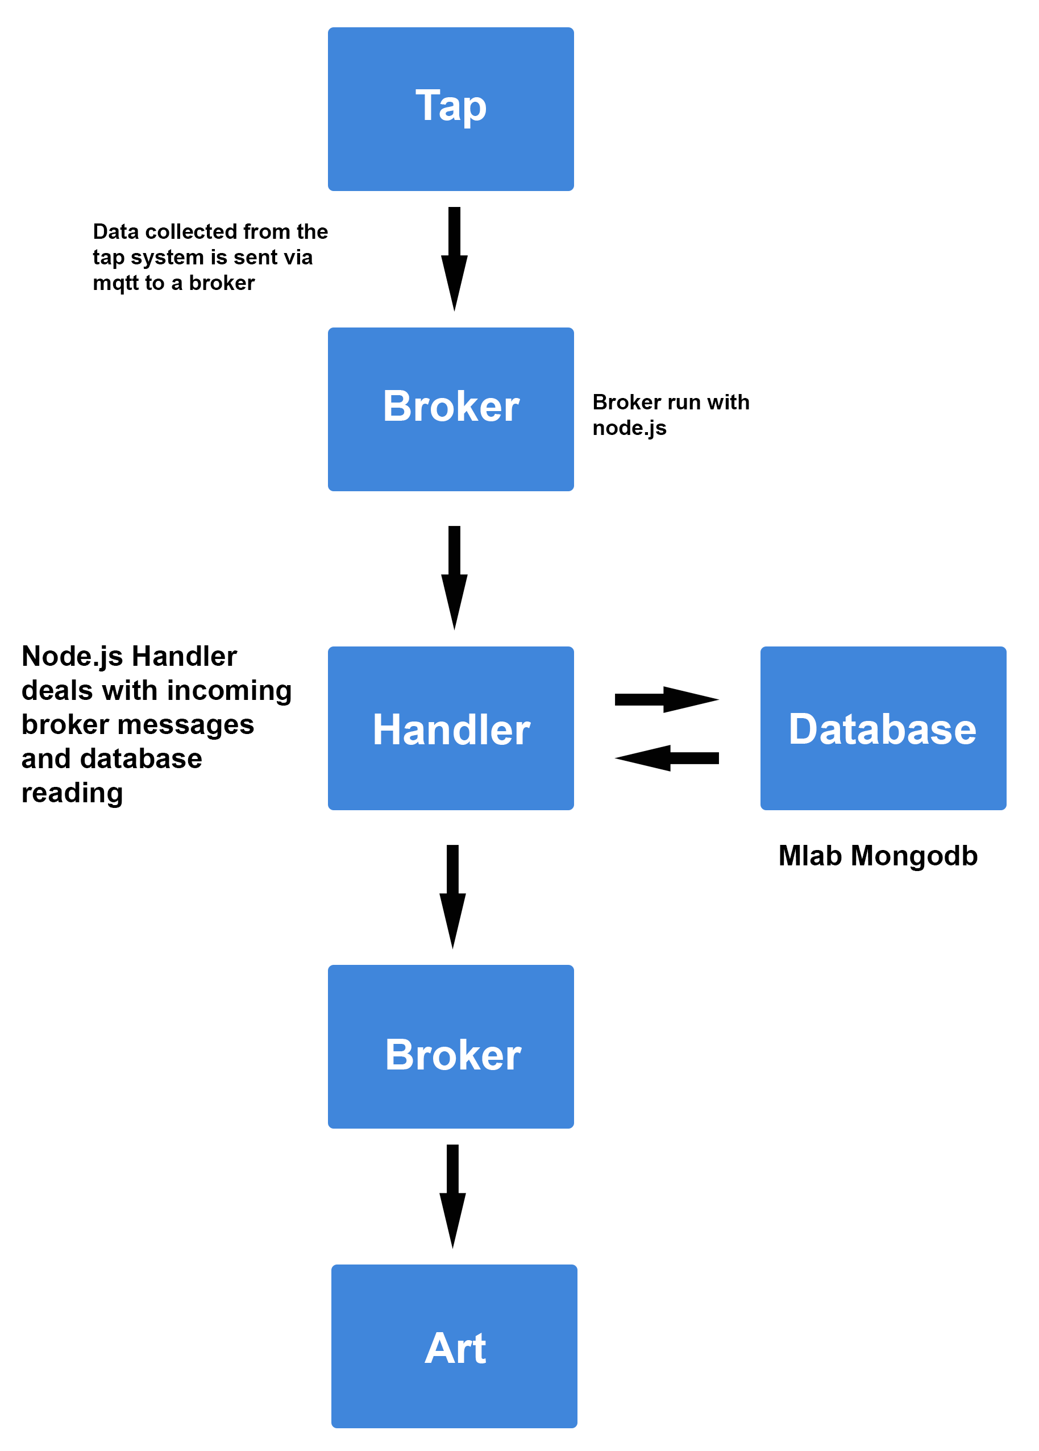
Project build
Aims and objectives of the build
A device and system to measure and store water consumption data at the tap within the home.
A live changing art piece mountable on the wall or free standing.
Works over the internet including database storage.
Artwork also to be able to work within a gallery setting.
The measurement device should be easy to set up without requiring any plumbing.

Slide 9
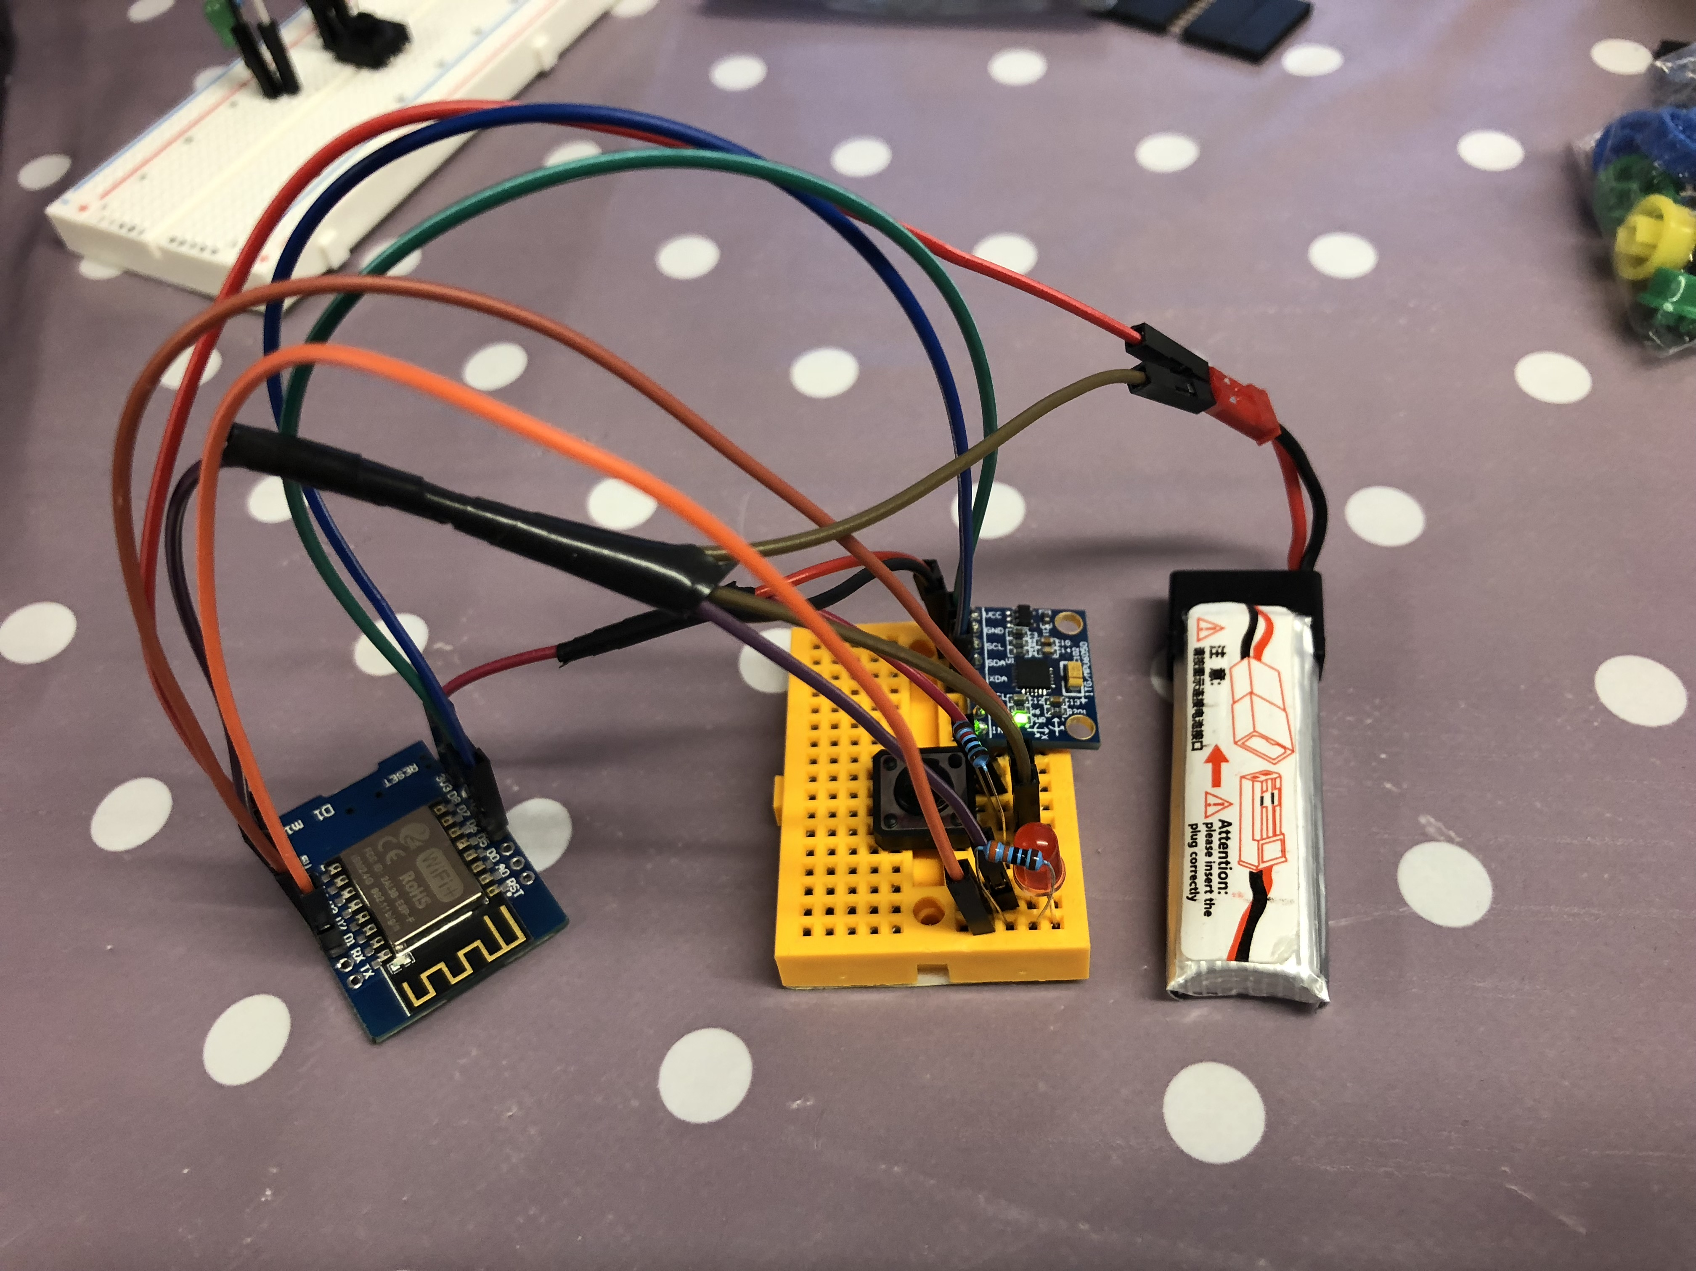
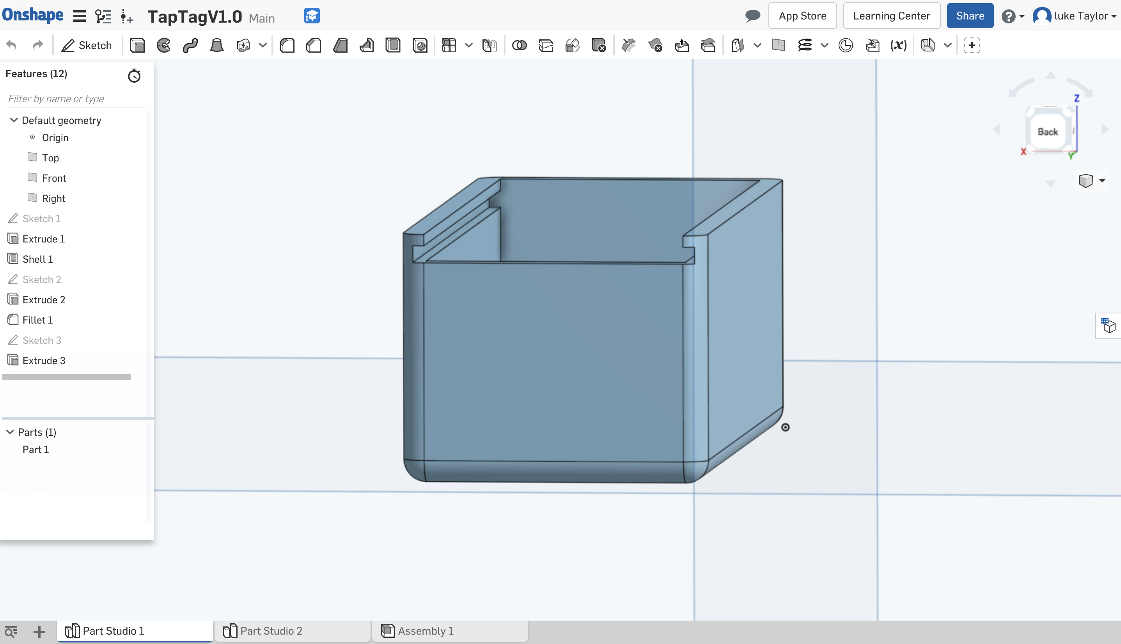
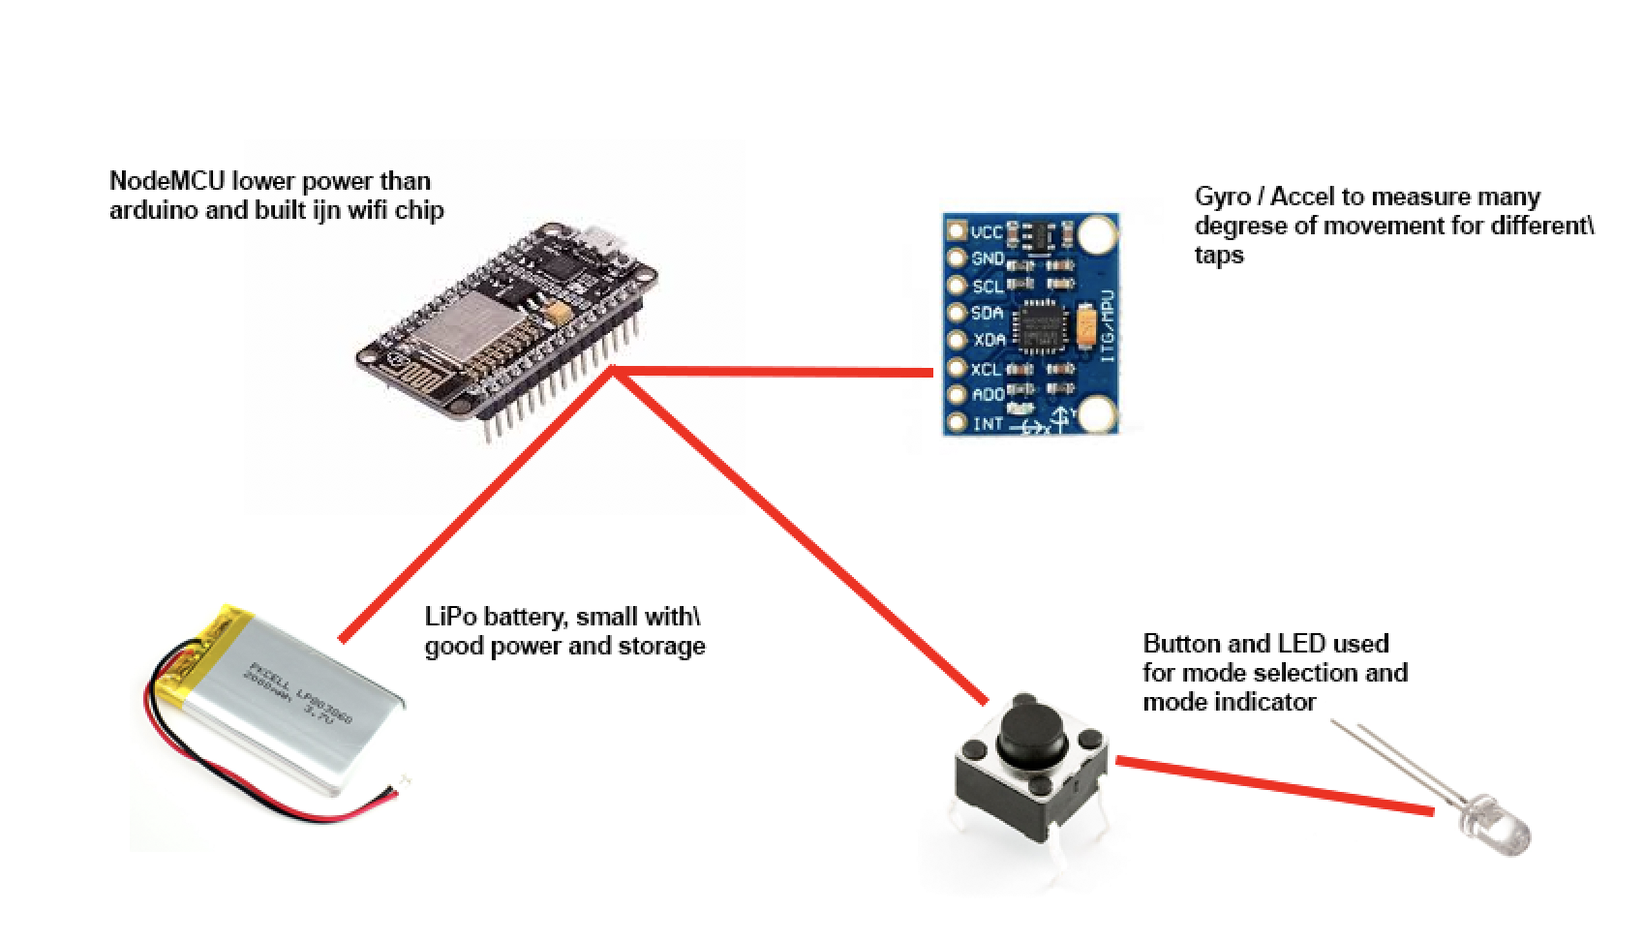
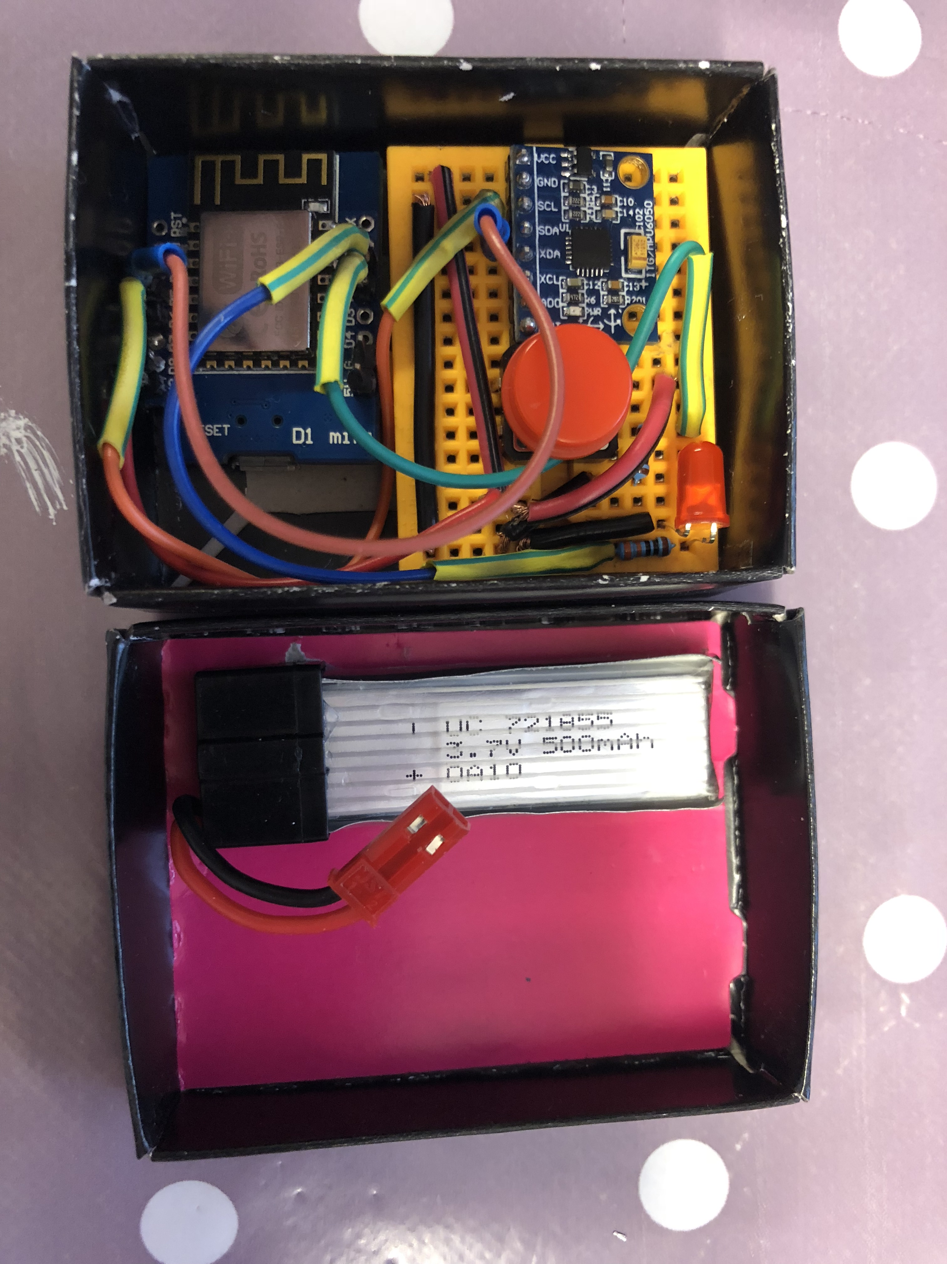
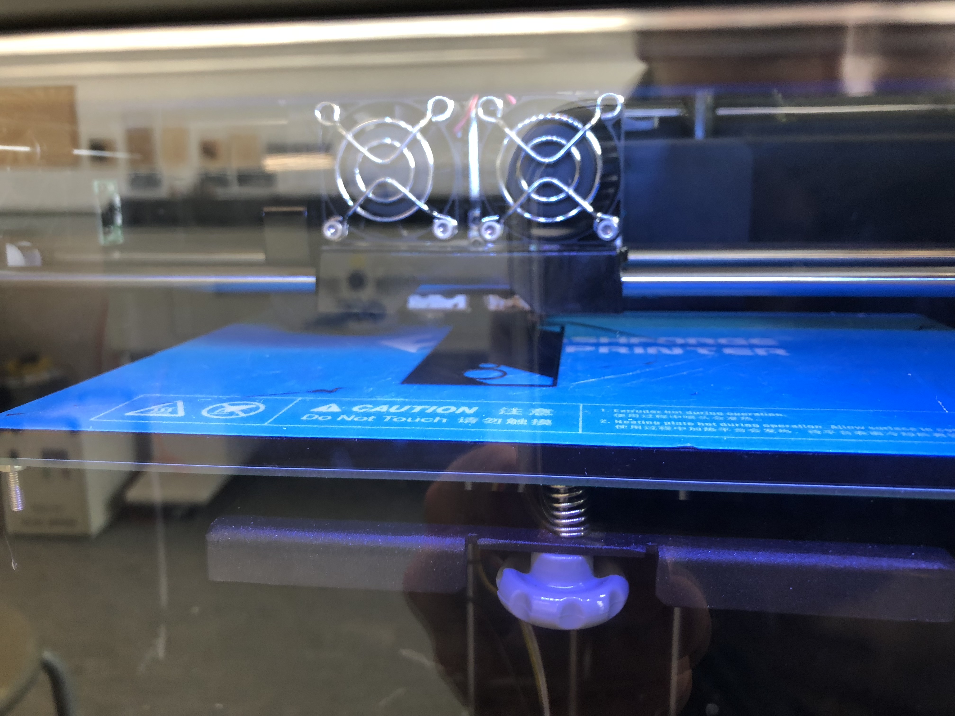
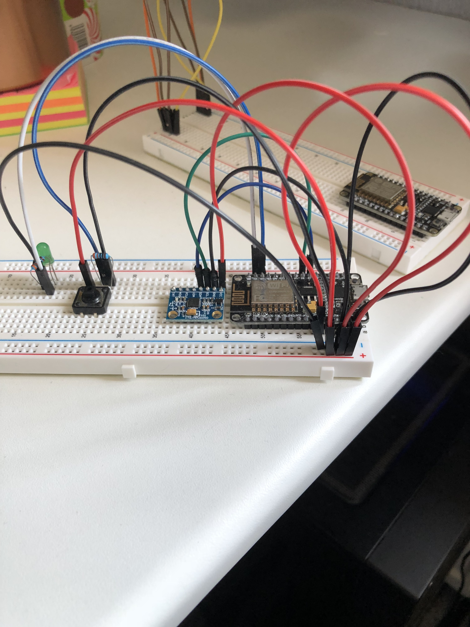
Project Build
Tag

Slide 10
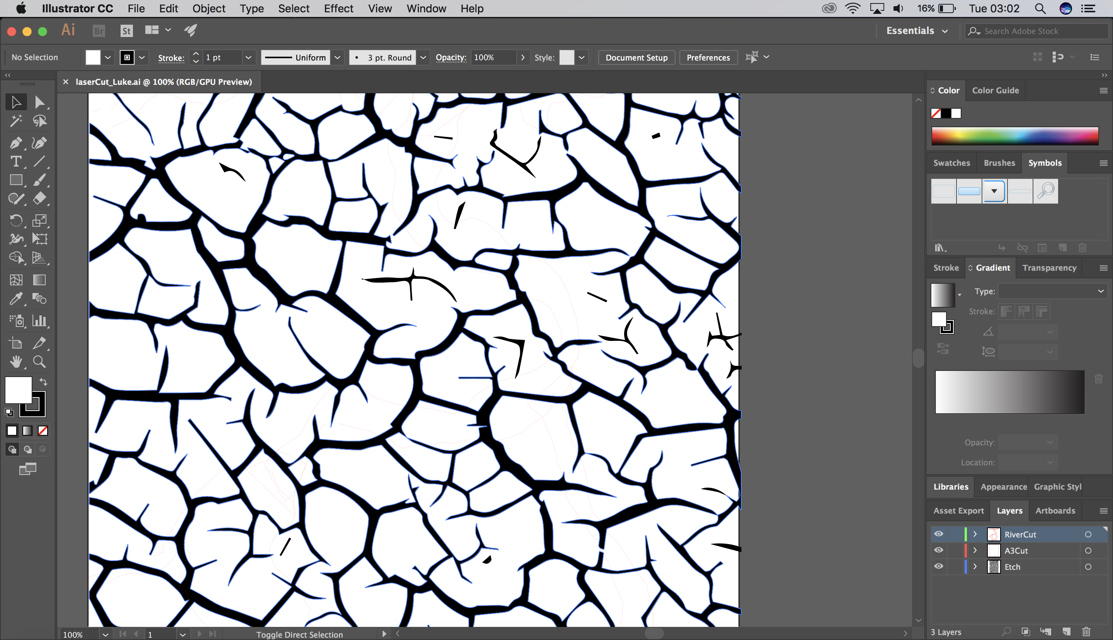
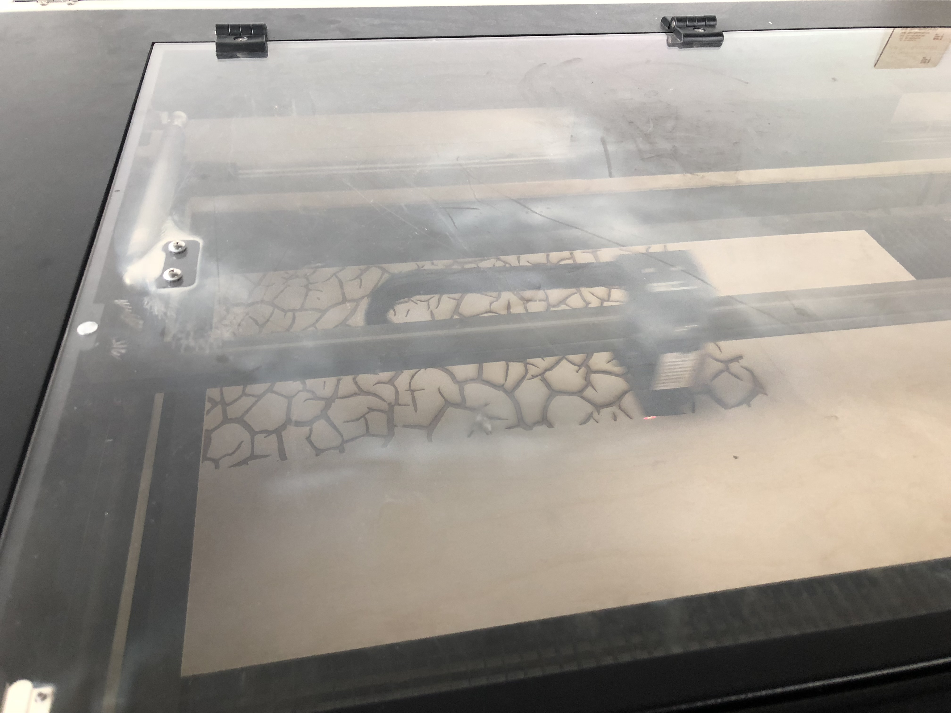
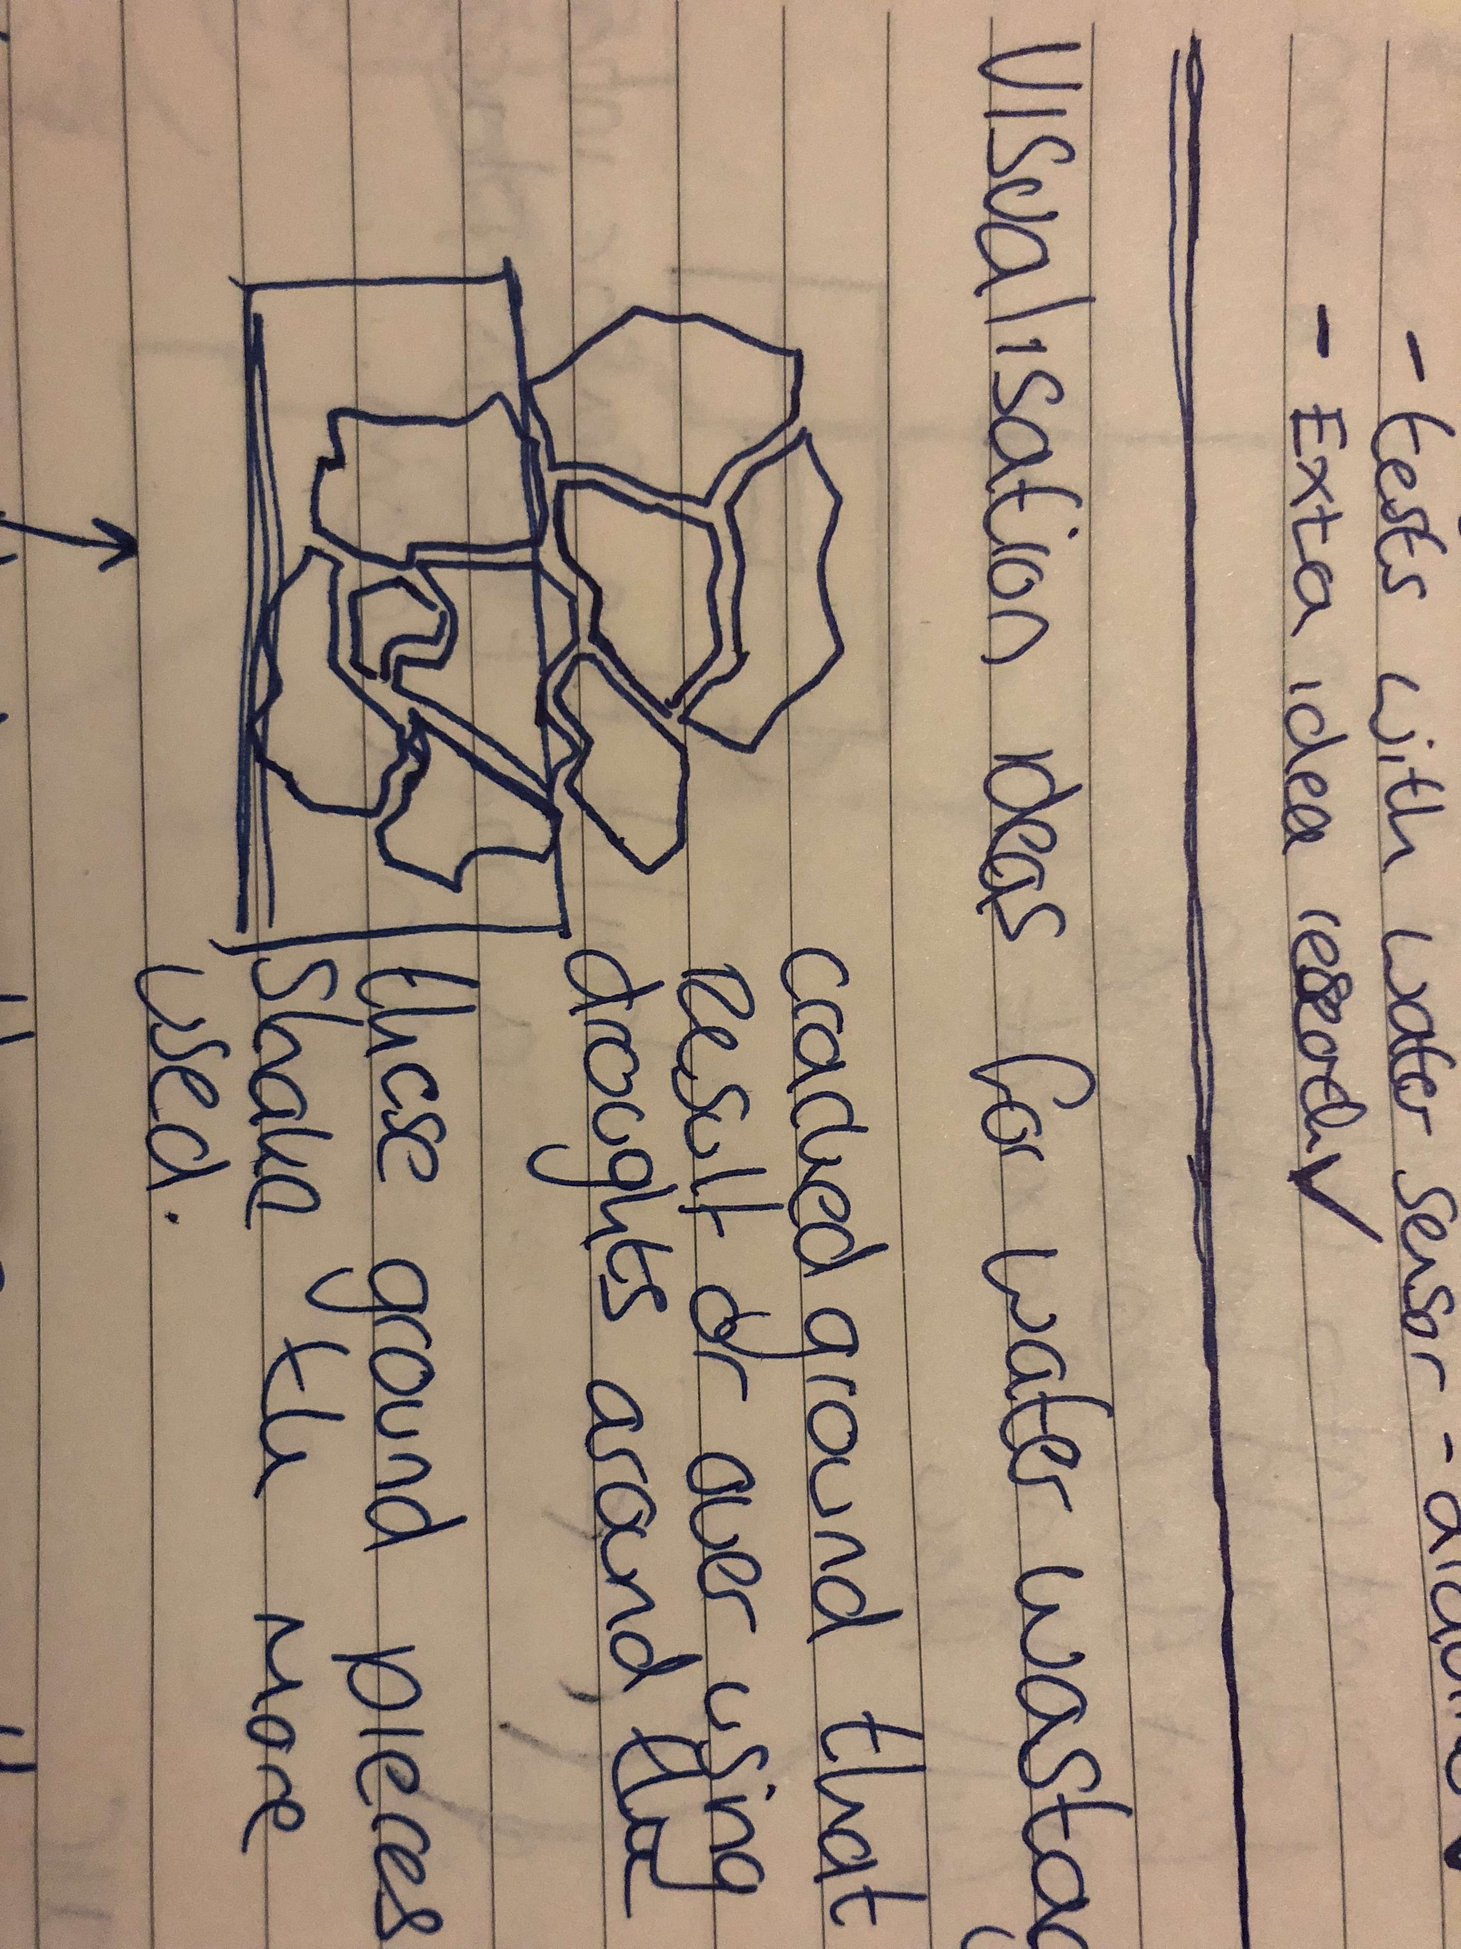
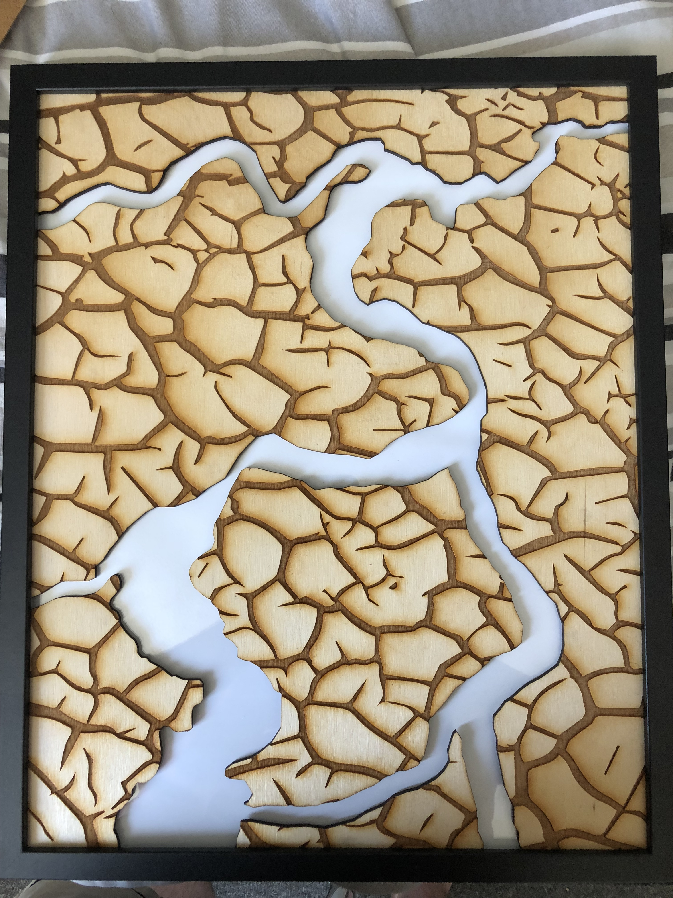
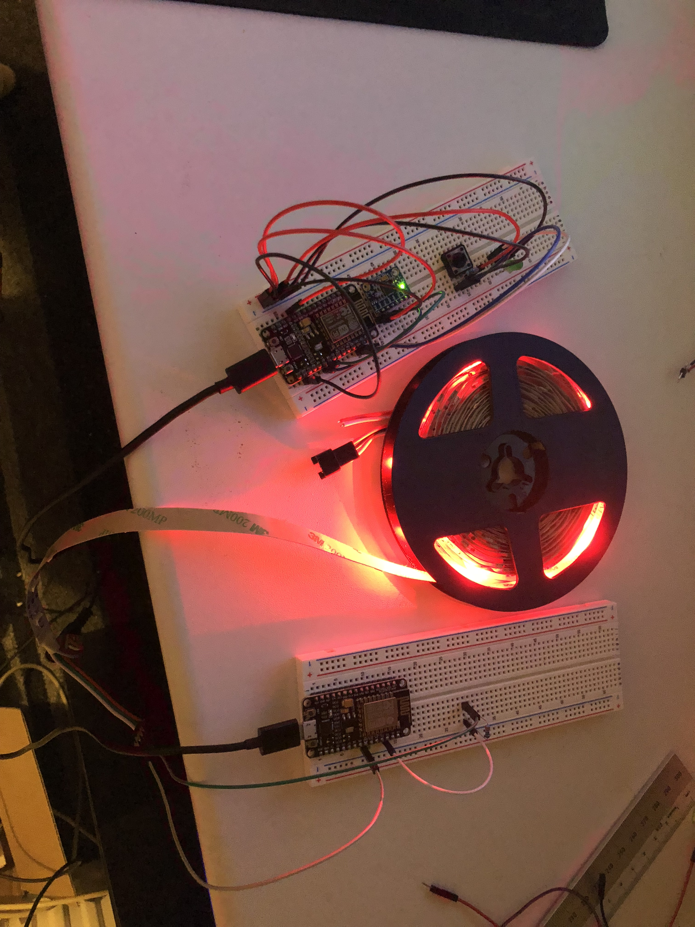
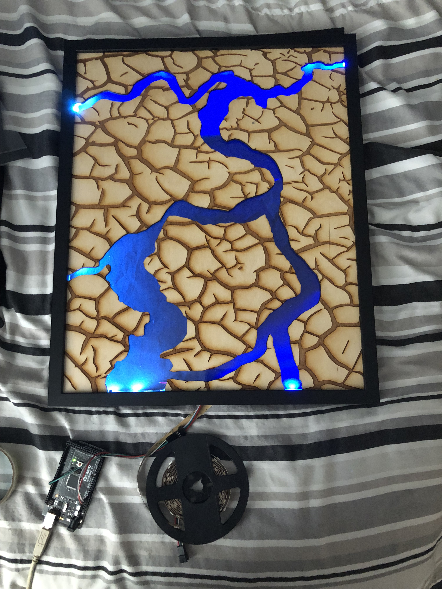
Project Build
Art

Slide 11
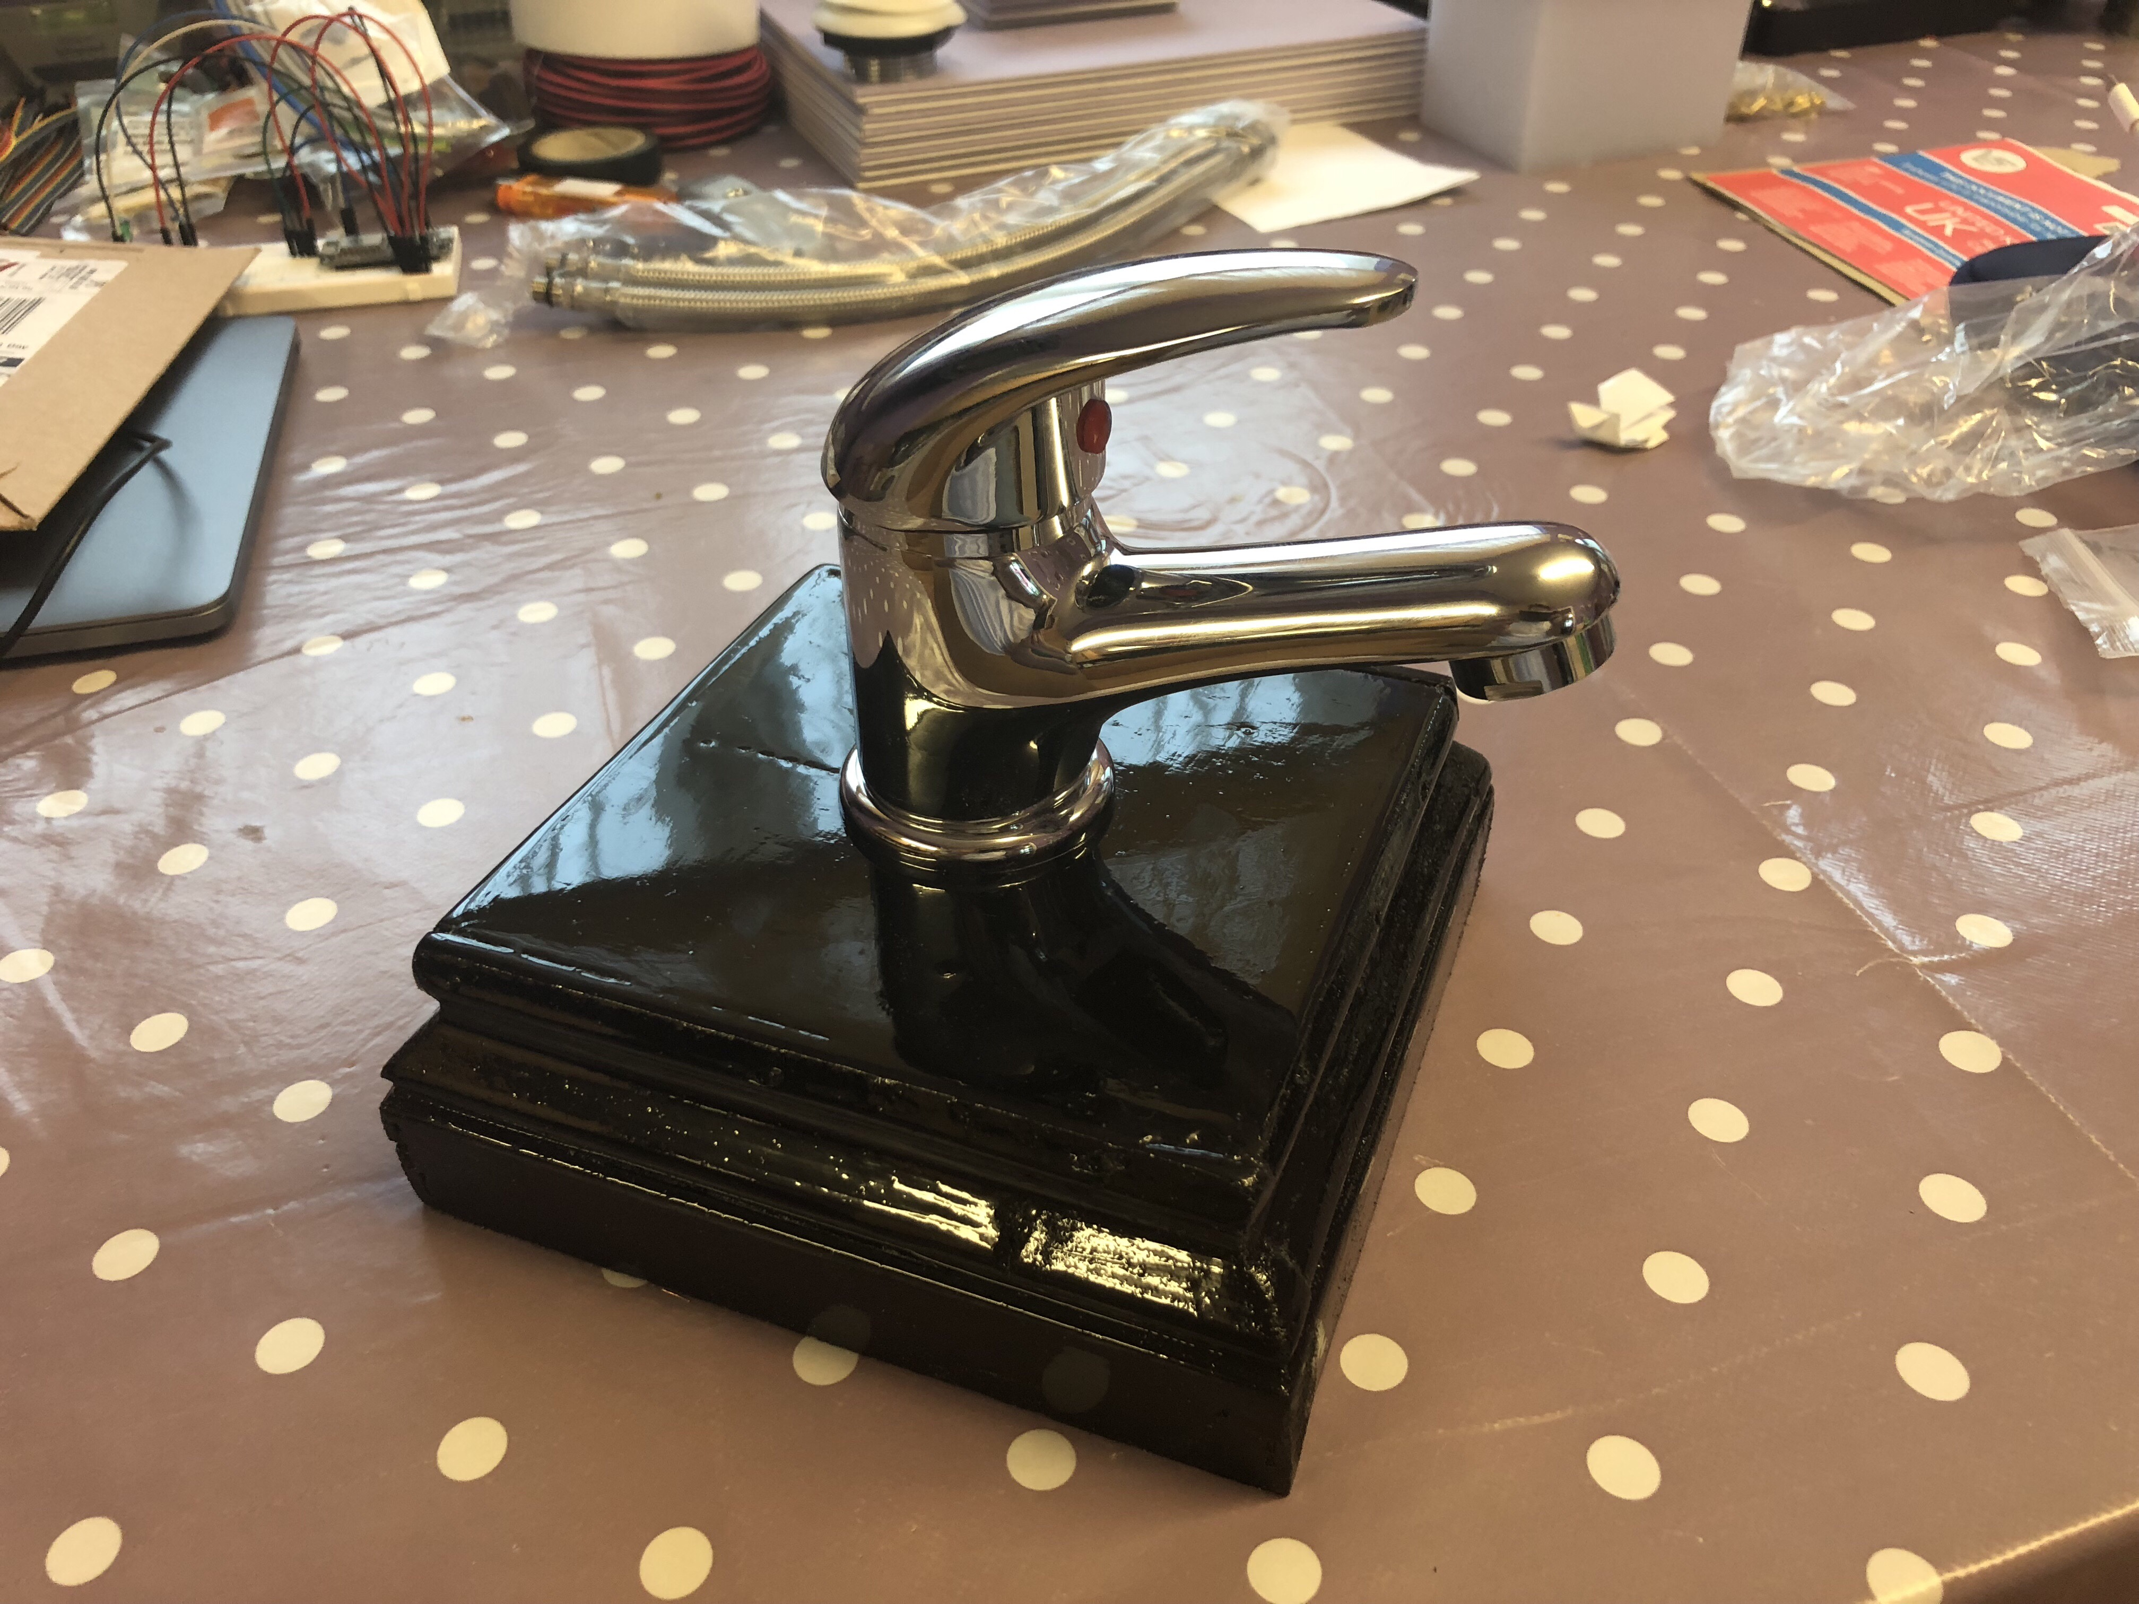
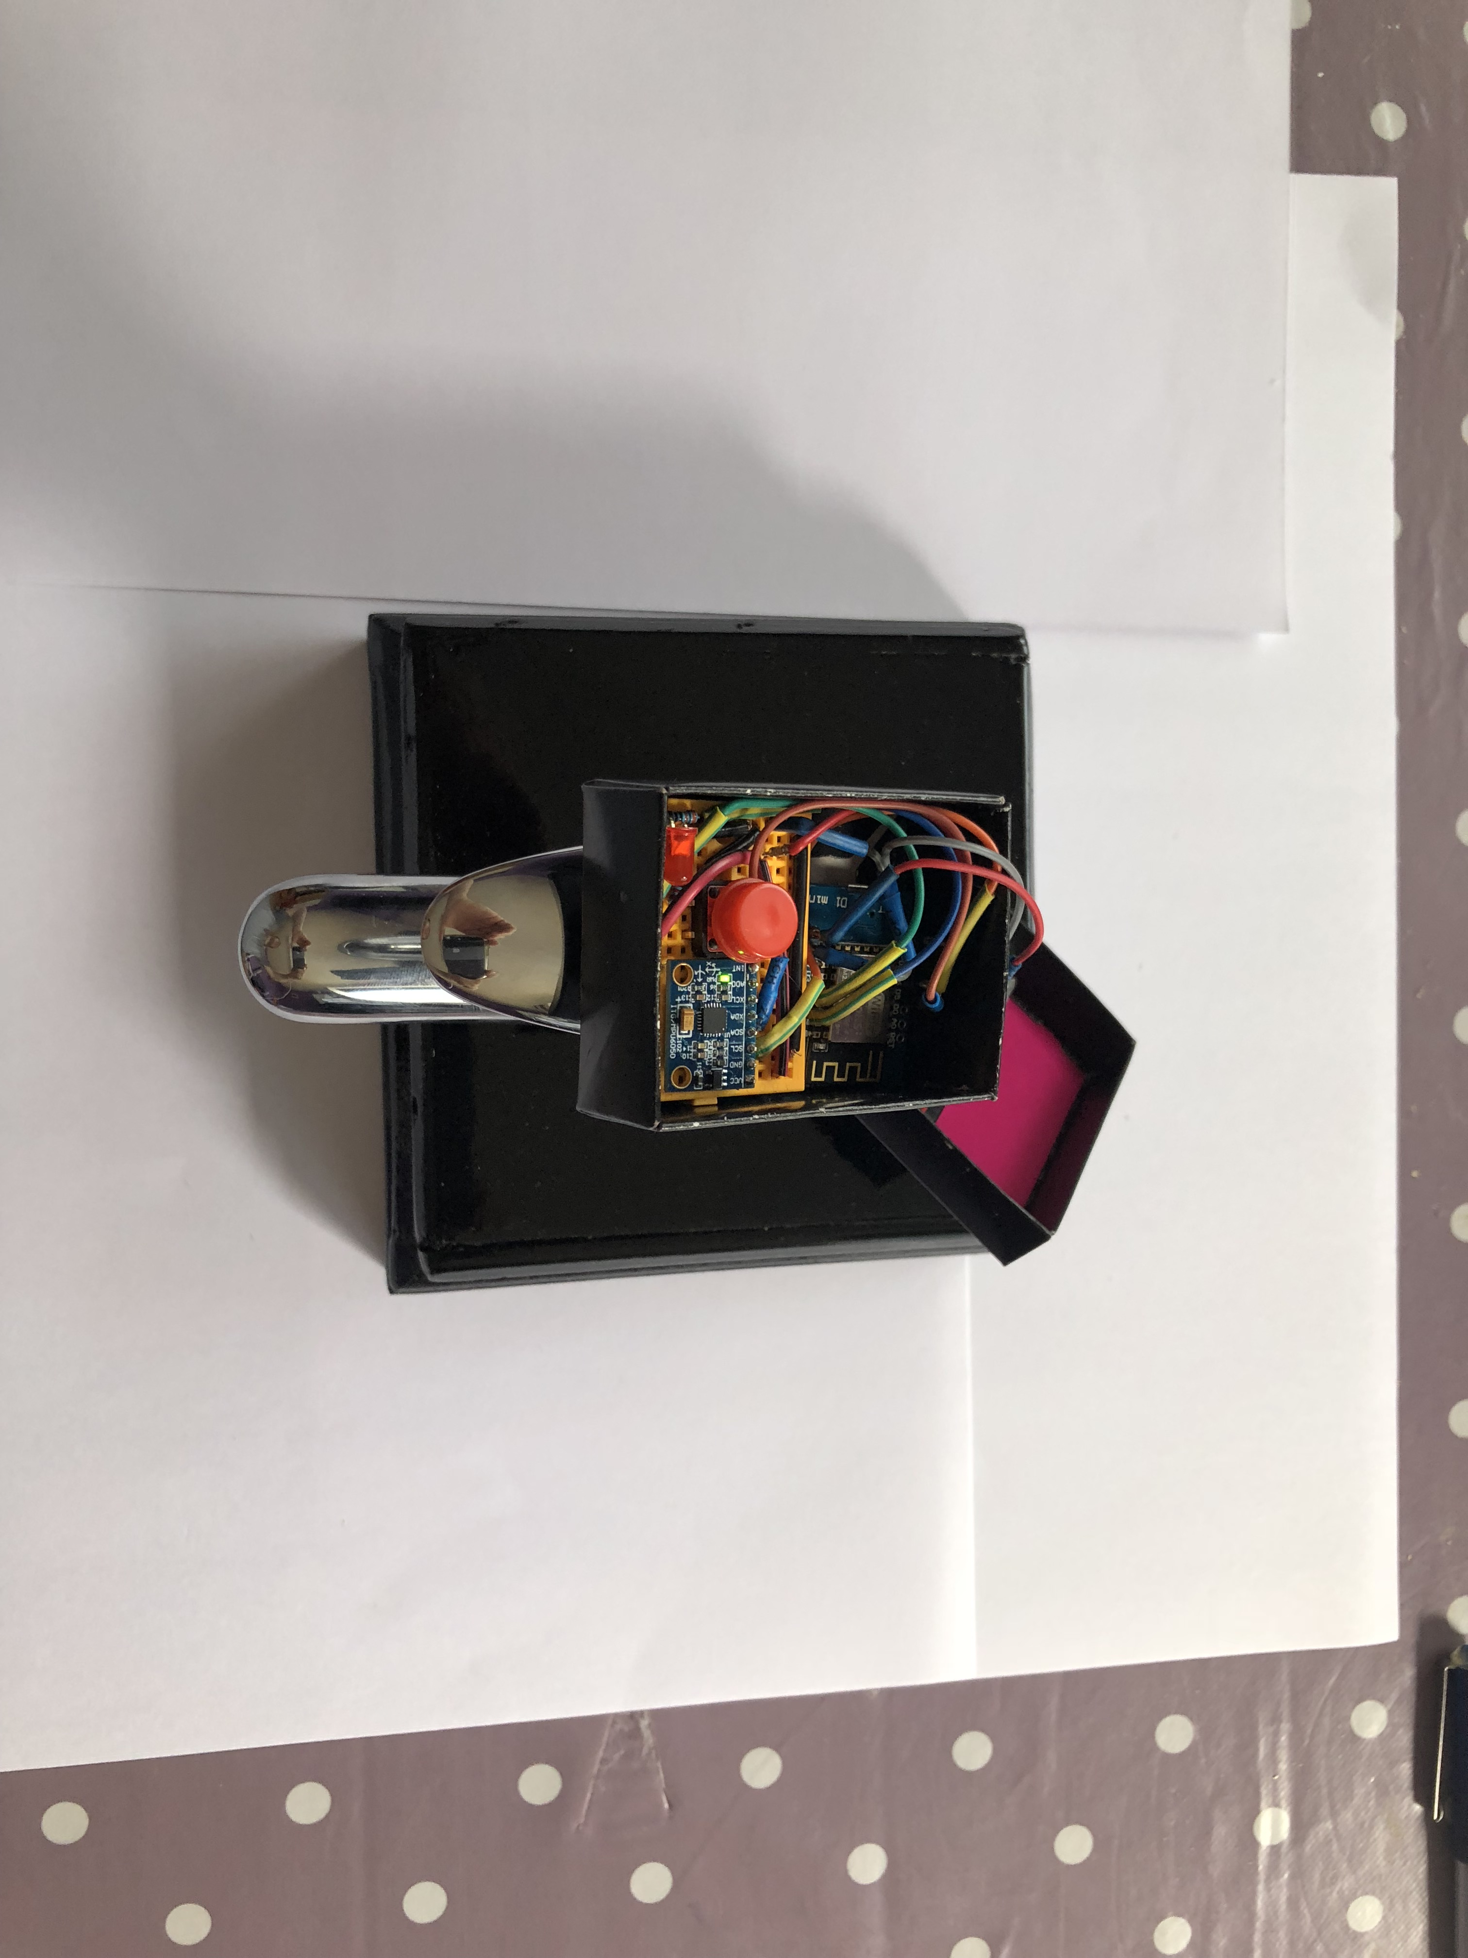
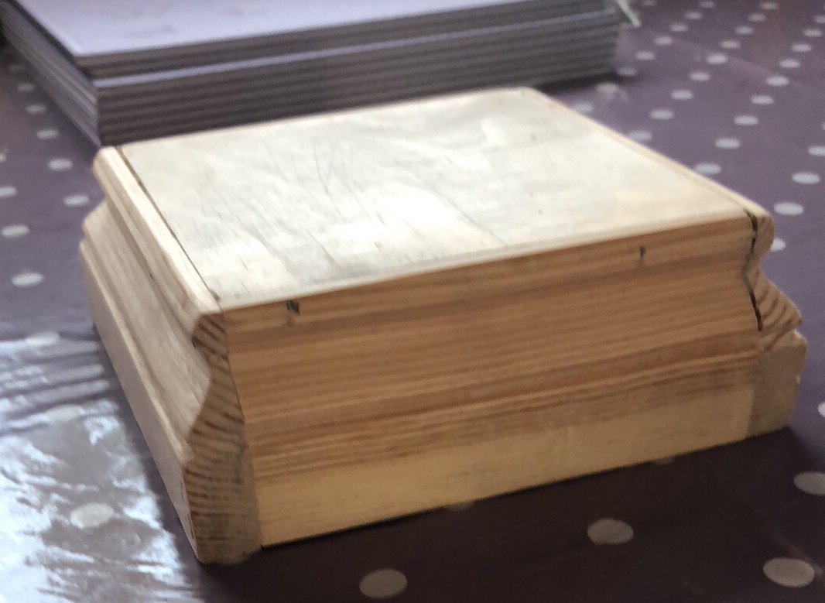
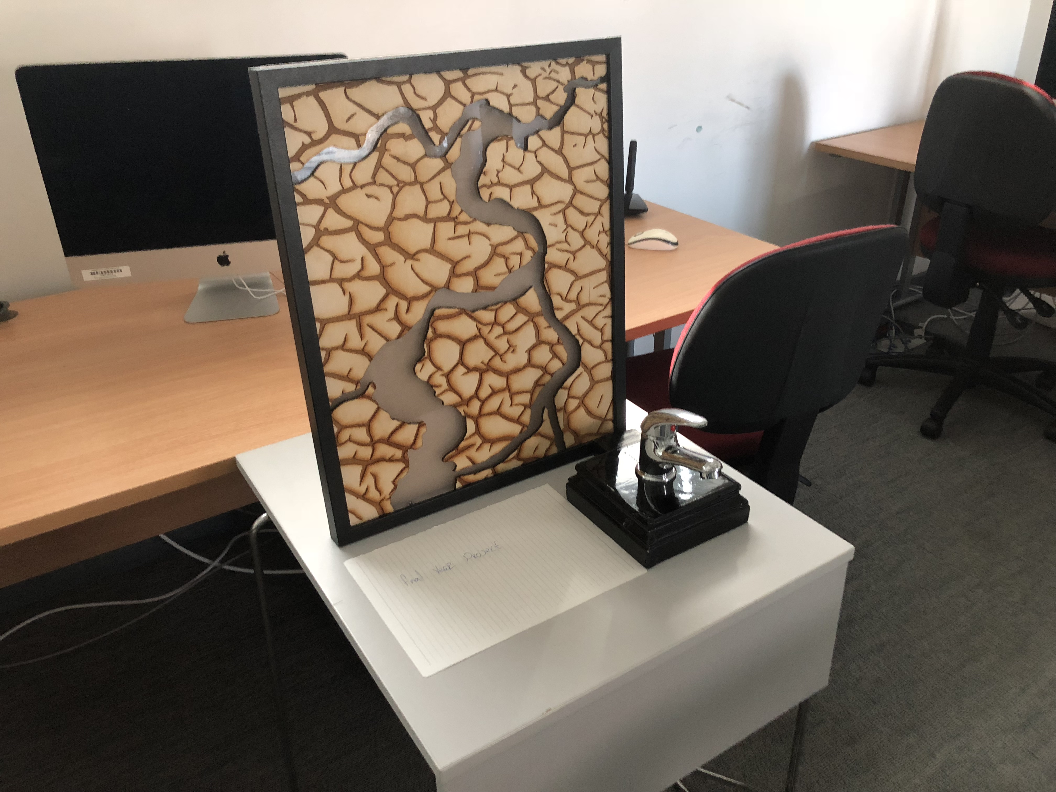
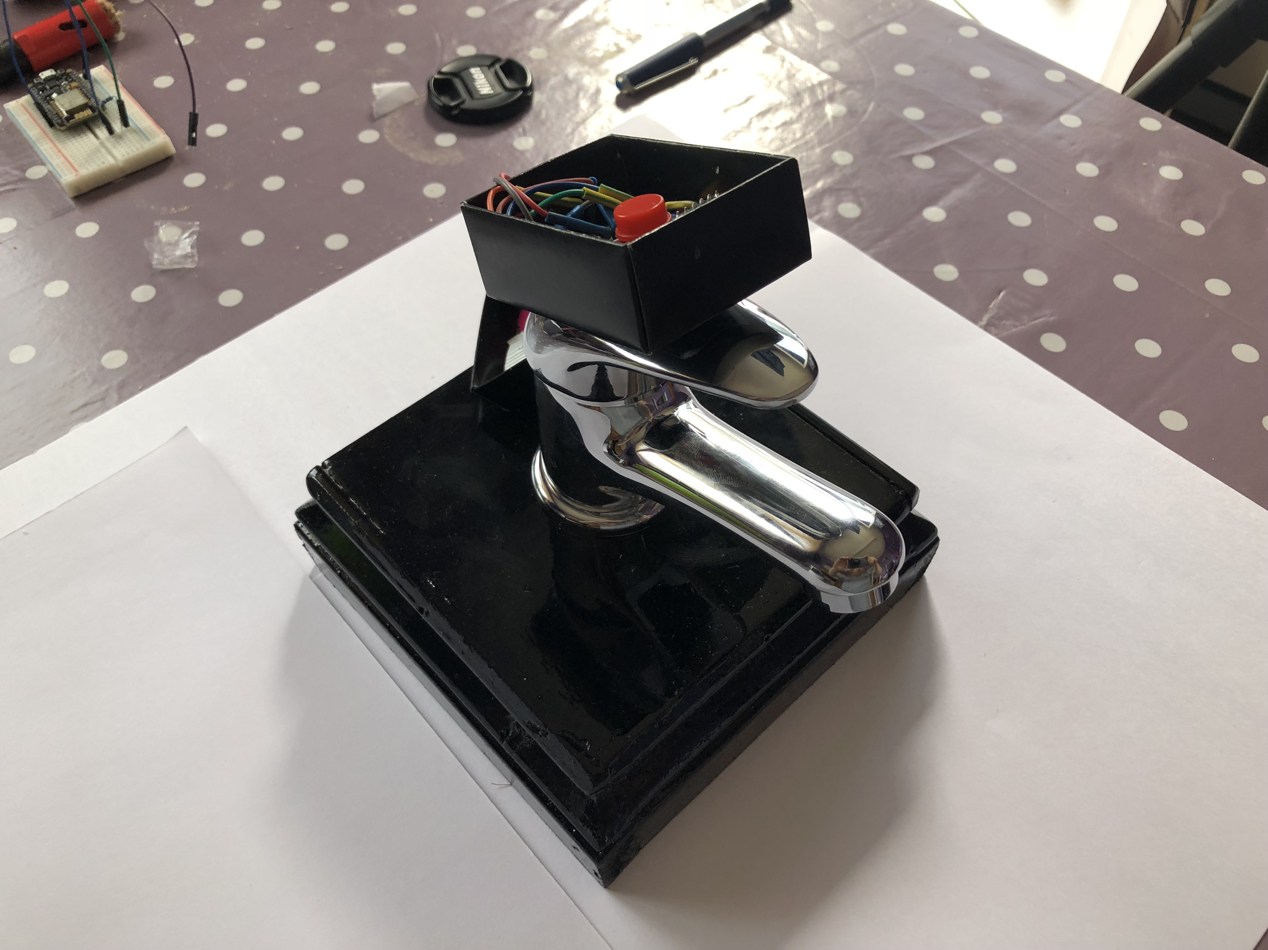
Project build
Demo

Slide 12
Reflection
Cons I wasn’t able to get a case 3D printed, the attempts all failed. The Tag turned out much larger that I had liked, the size currently of the prototype affects the use of certain tap too much. To charge the battery the it has to be completely removed from the tag, this is also necessary to start and stop the device. The material used to frost the glass on the art prevented the adhesion of the wood pieces, so I had to stick to the opposite side losing some of the effect I was after. There needs to be a better way to connect the device to the tap, currently the prototype is taped on.
Pros Managed to miniaturize the tag as much as possible, using custom wiring and clever placement and use of components. Managed to use LiPo battery technologies for longer life and better performance as well as reducing size. The tag has mode selection and will work with a number of different taps. The laser etching turned out great and adds greatly to the effect I am trying to create. A good mixture of technologies, skills and techniques (wood working, electronics, programming etc).

Slide 13
Reflection
Future Developments
Make the tag even smaller, this would require custom components and circuit boards specific for the task.
Make different style cases interchangeable so they can be swapped out to the one that best fits the tap style and doesn’t affect affordance.
Host the Node.js handler scripts and broker on a server so it can all run independently of my machine.
Find a better battery that is smaller and longer lasting.
Add a recharging circuit to the tag, so the battery doesn’t have to be removed to charge.
Continue to change the led program to look more like water and be effected by more variables (speed, brightness etc.).
I would like to create an experiment where I place the tags on the taps without the art installed for a month after which the art is installed for another month and compare the results to see if the art does have an effect of people behavior.
Create other tags suitable for different water sources (toilets, showers, washing machines etc.).

Slide 14
Conclusion
Overall I am pleased with the outcome of the project, I feel that I have managed to combine the internet of things into art and live data to achieve a system that can reliably read water usage without the need of any complicated installation, and have combined this data into an interesting live art piece that could fit within the home environment and that I believe will help people to realise that water is a finite resource that we are overusing and help them to make a conscious effort to waste less resources.

